Slide 1
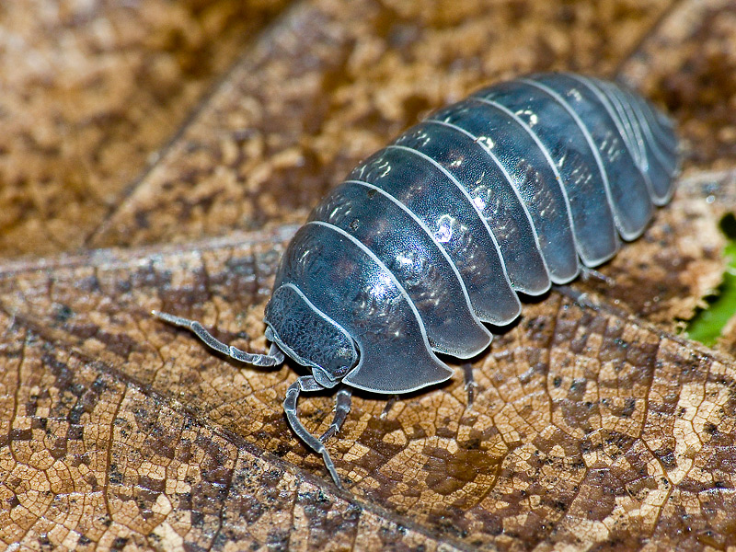
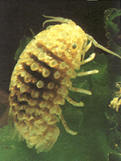
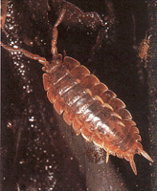
Isopods
AKA: Rolly-pollies

Slide 2
Natural History of Terrestrial Isopods
Classification
Kingdom: Animalia
Phylum: Arthropoda
Subphylum: Crustacea
Class: Malacostraca
Order: Isopoda

Slide 3
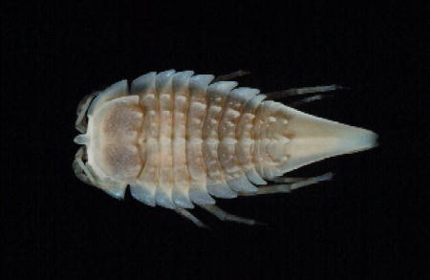
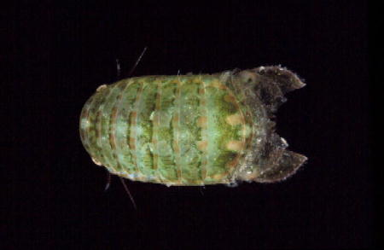
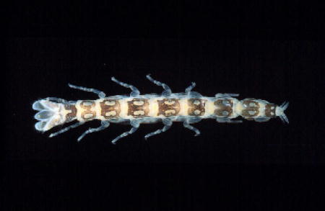
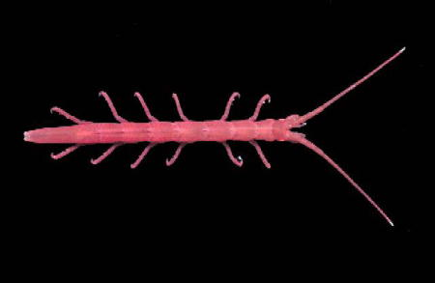
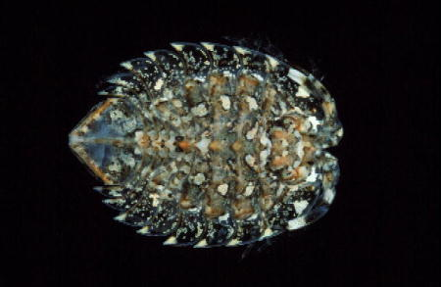
Isopods
Isopods are common inhabitants of nearly all environments. There are nearly 10,000 species.
They are unusual among the Crustacea for their abilities to live in so many different habitats.

Slide 4
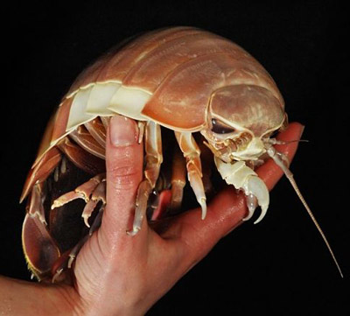
Variations in Isopods
The Isopoda include approximatly 10,000 described species, in 10 suborders.
These animals range in length from 0.5 mm to 500 mm (Bathynomus giganteus). (19.68 inches!)
Giant Isopod

Slide 5
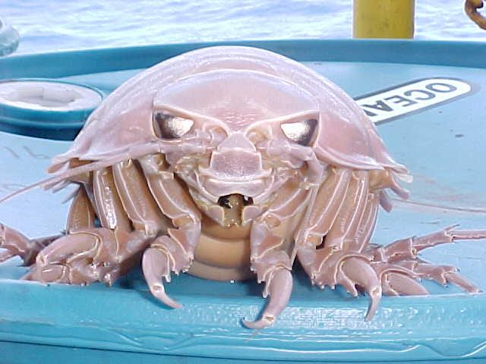
Giant Isopods of the deep Atlantic Ocean
Giant Isopods grow to an average of 14-19”.
They are an example of deep-sea gigantism— certain organisms grow to a much larger size than their shallow ocean cousins. Ex: Giant Squid (up to 14 meters—46’)
Scientists suggest that deep-sea gigantism could be a response to the pressure , lack of food (so delayed maturity), or temperature regulation.

Slide 6
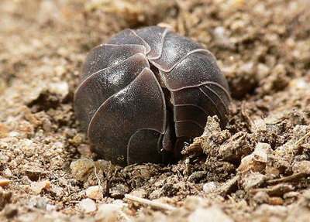
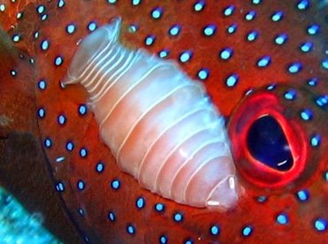
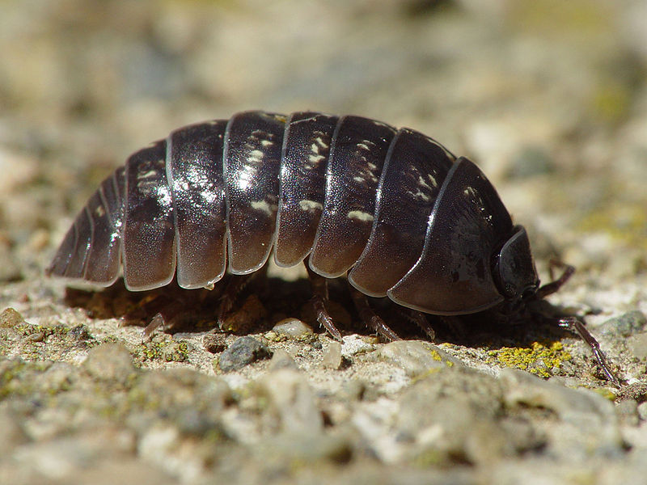
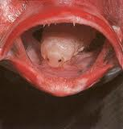
Diversity of Isopods
Parasitic Isopod
Pillbug
Sowbug
Tongue-eating Isopod

Slide 7
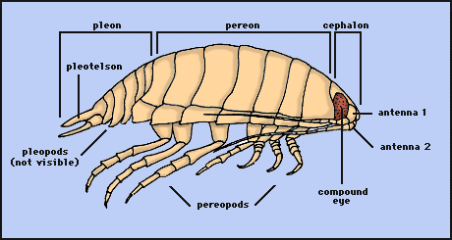
Body Structure of Isopods

Slide 8
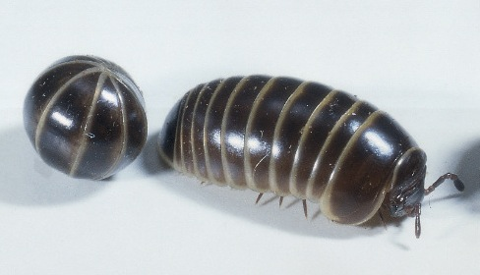
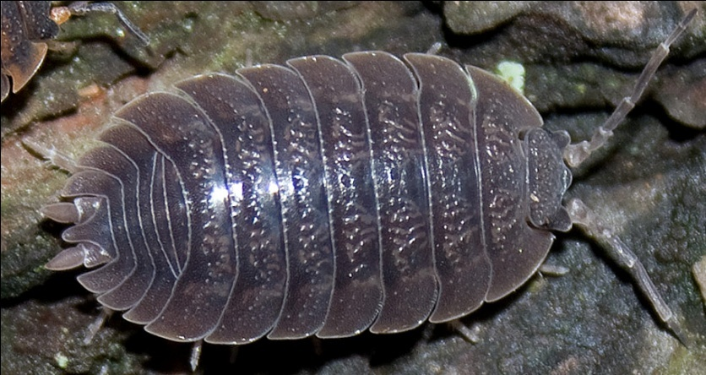
Morphology (appearance)
Three body parts: head, thorax, abdomen
One prominent pair of antennae (one inconspicuous pair)
Simple eyes
Seven pairs of legs
Seven separate segments on thorax
Paired appendages at end of abdomen called uropods

Slide 9
Isopods are Crustaceans—related to shrimp, crabs and crayfish
Like all crustaceans, isopods have a segmented outer shell that provides a measure of protection from the environment and predators.
Like their aquatic relatives,
isopods get oxygen through
gill-like structures located at
the bases of their legs. Thus,
terrestrial isopods must live
in a moist environment.

Slide 10
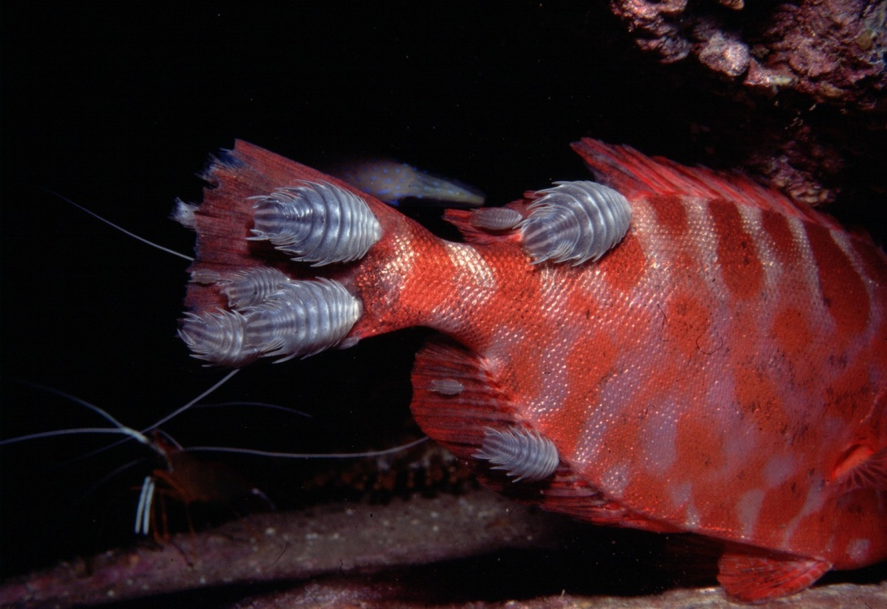
Feeding
Isopod feeding habits are extremely diverse.
They may be parasites, carnivores, herbivores, and detritivores.
The isopods we will be studying are detritivores.
Nerocila acuminata is a parasitic isopod that attaches to the skin of a variety of marine fishes.

Slide 11
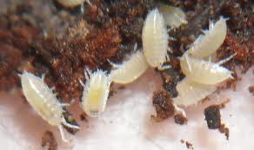
Isopod Development
Isopod embryos undergo direct development within the female brood pouch (marsupium), from which they emerge as juveniles, known as manca.
Isopod Juveniles

Slide 12
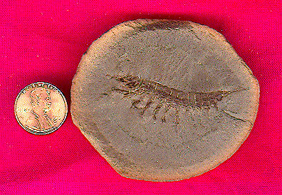
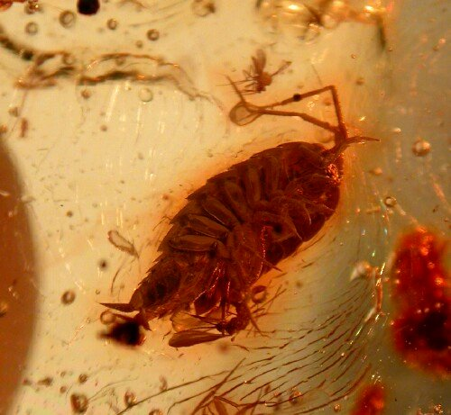
Evolution of Isopods
Isopods apparently evolved in shallow marine environments by at least the early or mid-Paleozoic.
The earliest fossil records of isopods are phreatoicids dating from the Pennsylvanian (the Carboniferous Period of the Paleozoic Era), 300 million year ago.

